Slide 1
Wine Sales Analysis
Analysis – Documentation by Bhuvana Krishnasamy

Slide 2
About Wine Sales Analysis
Wine Sales Analysis documentation will provide insights about analysis on wine sales data. This dashboard will provide the insights about the following questions
Which varieties accounted for the fewest bottles sold in 2022?
What were the top 3 varieties of wine based on gross profit in 2023?
Which country accounted for the highest gross revenue compared to other countries in 2022?
What is the trend of gross revenue over time by month within the year?

Slide 3
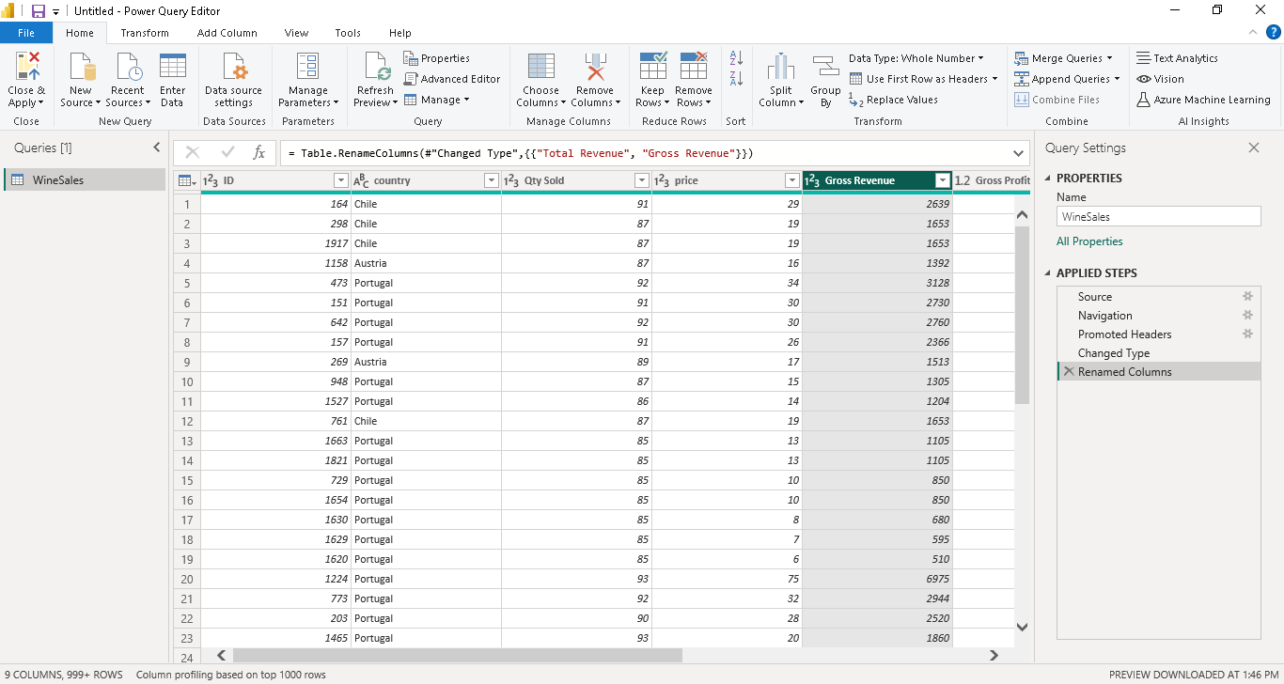
Item 1 - Renamed the column “Total Revenue” column to “Gross Revenue”.
Renamed the column by selecting the corresponding column and right click → Rename column name → enter the name.

Slide 4
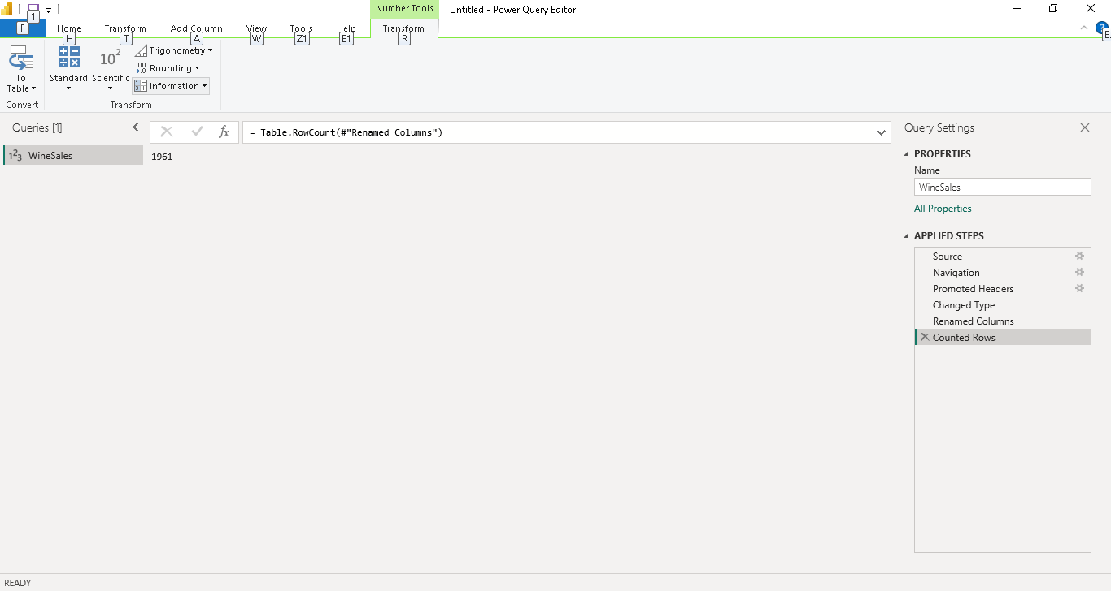
2. How many rows were loaded into Power BI? How did you determine this?
Determined the no of rows loaded into Power BI by using Count Rows function. Transform data → Transform → Count Rows.

Slide 5
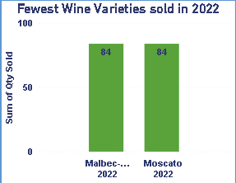
Item 2 – Data Visualization
1. Which varieties accounted for the fewest bottles sold in 2022?
Malbec – Tannat & Moscato are the two wine varieties sold with less bottle count in 2022

Slide 6
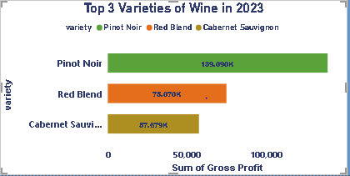
2. What were the top 3 varieties of wine based on gross profit in 2023?
Pinot Noir , Red Blend, Cabernet Sauvignon are the top 3 varieties of wine sold based on gross profit in 2023.

Slide 7
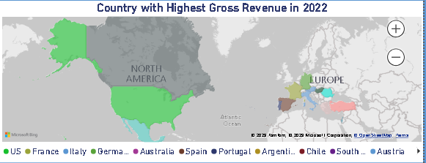
3. Which country accounted for the highest gross revenue compared to other countries in 2022?
USA accounted for highest gross revenue when compared with other countries in 2022.

Slide 8
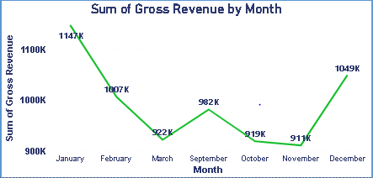
4. What is the trend of gross revenue over time by month within the year?
Trend in gross revenue is shown using Line chart. The downward line shows there is downturn in sales and there by decrease in revenue till March and there is ups & down in revenue and finally at the end of the year the sale was more and there is upturn in revenue.

Slide 9
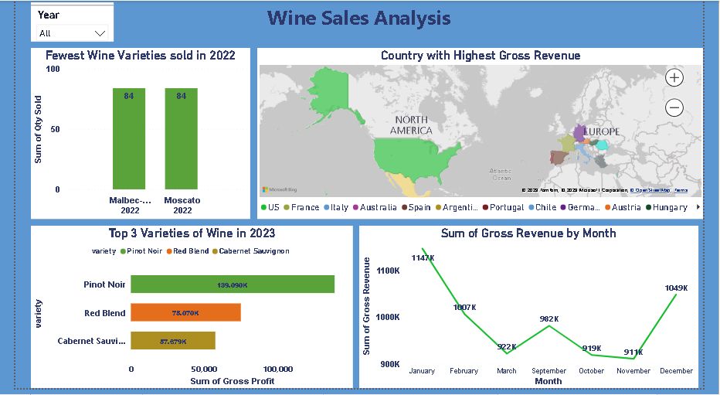
Wine Sales Analysis Dashboard

Slide 10
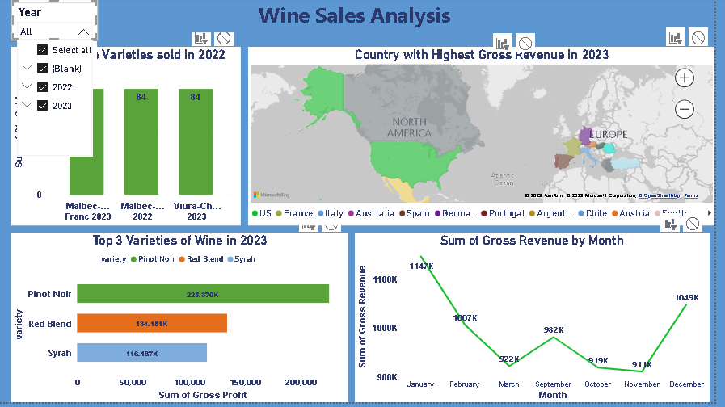
Sales Analysis - Overall.

Slide 11
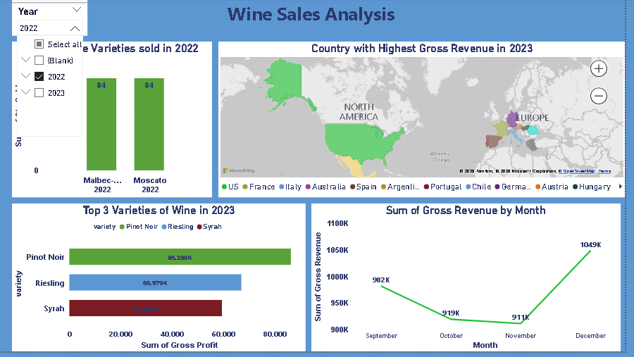
Sales Analysis - 2022

Slide 12
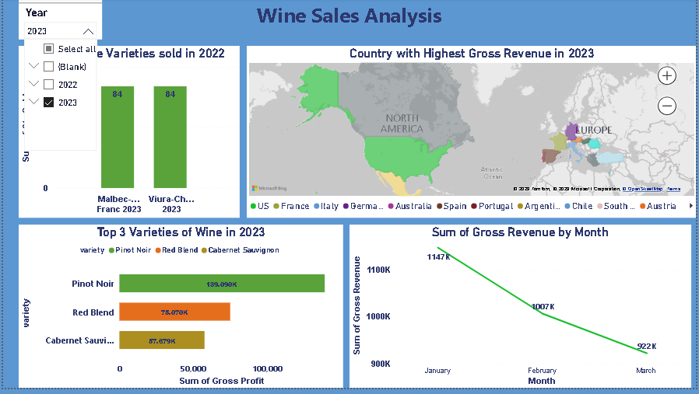
Sales Analysis - 2023

Slide 13
Thank You

